Slide 1
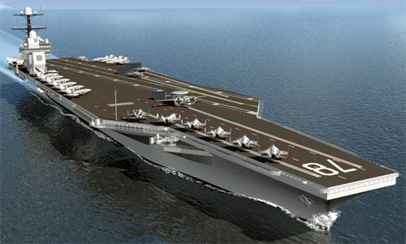
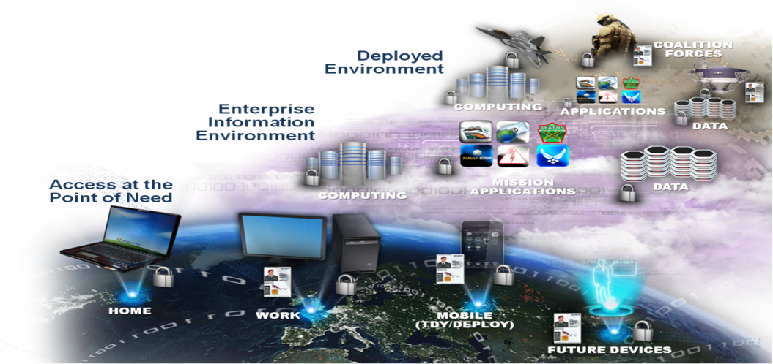
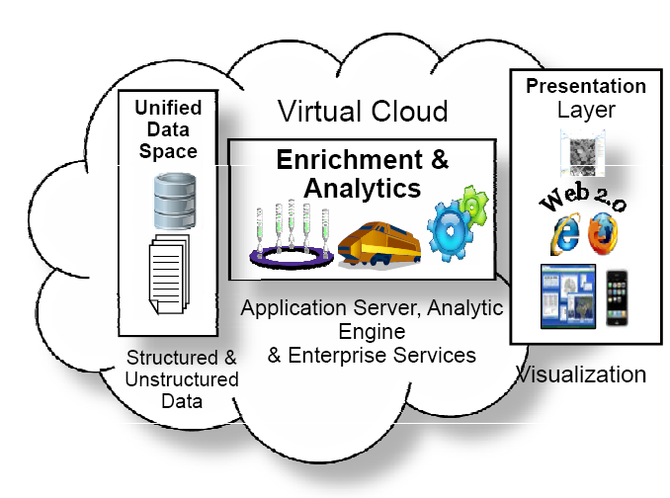
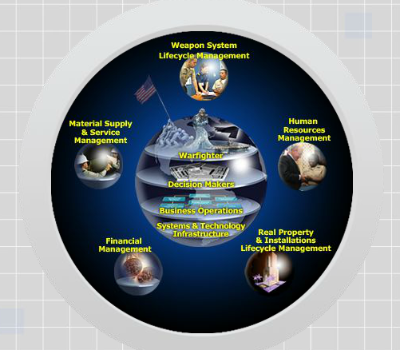
Lines of Sight and Provable Traceability
Warfighter Mission Area
Information Mission Area
Presentation by Mr. David McDaniel and Gregory Schaefer
Silver Bullet Solutions, Inc.
2014 Integrated EA Conference
Intelligence Mission Area
Business Mission Area
Notes:
This cover slide shows the four mission areas of the US DoD
In the upper left, the warfighting mission area is probably the most familiar to people
To the right is the Information Mission Area for which the Chief Information Officer has responsibility. Our big project now is the Joint Information Environment focused on core data centers, enterprise services, and common and standardized nodes, security, IDaM, VOIP, teleconferencing, services, and so on.
On the bottom left is the Intelligence mission area which, like the JIE, has a counterpart for the intelligence networks.
Last but not least is the Business Mission Area focused on HR, Real Property, Acquisition, medical and health, finance.
All of these have architectures to lay out new requirements and how all the pieces should work together and so it is very important that solutions that are developed are traceable to the architectures and, hence, the purpose of this work.

Slide 2
Presentation Outline
Why traceability is important
Issues with traceability
Ontology and predicate calculus of traceability
Application to architectural patterns
Summary and possible future work

Slide 3
Why traceability is important
Cartoon
Traceability is flip side of reification
JIE example

Slide 4
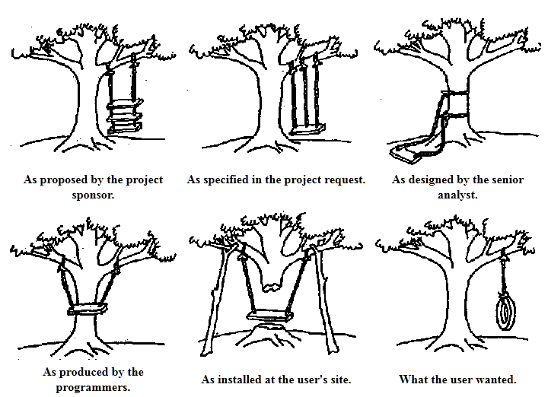
The old, “what the customer wanted”

Slide 5
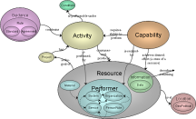
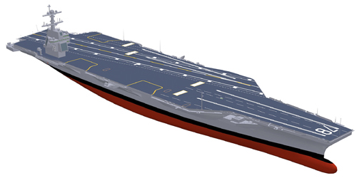
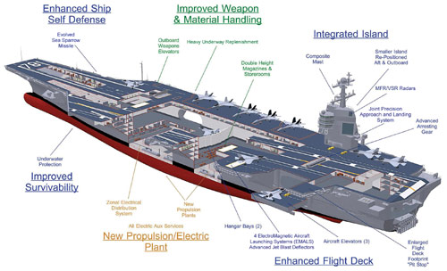
Traceability = Reification⁻¹
AN ARCHITECTURAL
DESCRIPTION:
IDENTIFIES
Traceability
(Pedigree)
Rules constrain (requirements)
DEFINES
Traceability
(Pedigree)
Rules constrain (requirements)
REPRESENTS
Traceability
(Pedigree)
Rules constrain (requirements)
SPECIFIES
Traceability
(Pedigree)
Rules constrain (requirements)
CONFIGURES
Traceability
(Pedigree)
Rules constrain (requirements)
INSTANTIATED
5
Notes:
Successive refinement of the Architectural description. For any phase, it is traceable to the prior (pedigree). The prior phase becomes the rules that constrain the activities of the next performer – adherence to requirements baseline.
They’re all aiming at the same future Thing, just describing it in different ways as you go along.
Zachman’s vocabulary for reification: Identification-Row 1, Definition-Row 2, Representation- Row 3, Specification-Row 4, Configuration-Row 5 and Instantiation-Row 6

Slide 6
DoD’s Joint Information Environment (JIE) Project
Requirements documents, e.g., CONOPS
Capabilities Definition
Enterprise Architecture
Topic Architectures (6)
Solutions Architectures (12 X 3)
End-state objectives
Holism
Standards
Commonality
System
System of Systems (SoS)
SoS Elements
Family of Systems (FoS)
DoD Component System/Service Specs for RFPs, working capital fund taskers, etc.
Joint & Service Doctrine, Tactics, Techniques, & Procedures (TTP), training, etc.
Test and compliance plans and procedures

Slide 7
Challenges with traceability
Document orientation
Element orientation

Slide 8
Document Oriented
Defense Acquisition University
INCOSE
List of Sources (include date & revision number) |  | Requirements Source: |  |  | Requirements Extractor:
 |  | Requirements Source: |  |  | Requirements Mapper:
 |  | Specification Reference: |  |  | Requirements Verifier (Test):
 |  | Design Reference: |  |  | Matrix Reviewer:
Req Id | Requirement Name | Requirement detail | Priority | Test Scenario Name | Req Type | Test Method | Status | Owner | Comments

Slide 9
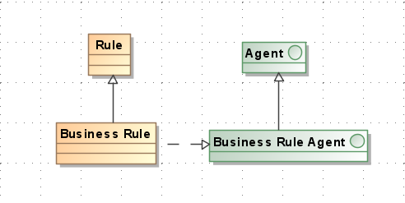
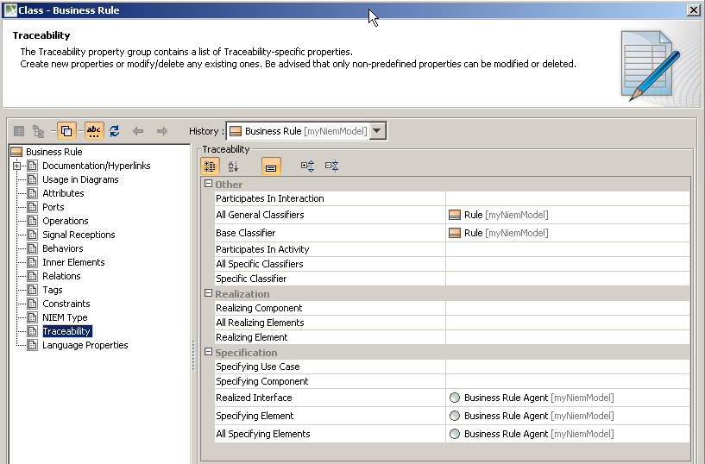
MBSE Tools
Many relationships across many diagrams
Traceability is a embedded menu per element

Slide 10
Ontology and predicate calculus of traceability
International Defence Enterprise Architecture Specification (IDEAS)
Predicate calculus of key IDEAS relationships

Slide 11
IDEAS Summary
International Defence organizations
Upper level consistent with SUMO and ISO 15926
Set theory
4-D mereotopology
The DoDAF Meta Model simply extends from IDEAS

Slide 12
Notation for WholePart

Slide 13
Validation for Relationship Type: wholePart
Part
A1
wholePart
B1
Whole
Validation Check:
Every part of A1 must have at least one overlap with a part of B1
If all the parts of A1 have a wholePart with the any part of B1, then A1 must be a part of B1
If any part of A1 has an overlap with any part of B1, then A1 must overlap B1
wholePart
wholePart
A
1.1
A
1.2
B
1.1
B
1.2
A1.2
A1.2
A1.2
A1.2
A1
A1.1
A1
A1.1
A1
A1.1
A1
A1.1
B1.1
B1.2
B1.1
B1.2
B1.1
B1.2
B1.1
B1.2
B1
B1
B1
B1
A1.2
A1.2
A1.2
A1.2
A1.1
A1
A1.1
A1
A1
A1
A1.1
A1.1
B1.1
B1.2
B1.1
B1.2
B1.1
B1.2
B1.1
B1.2
B1
B1
B1
B1

Slide 14
Validation for Relationship Type: WholePartType
PartType
A1
WholePartType
B1
WholeType
A
1.1
SST/WholePartType
A
1.2
B
1.1
SST/WholePartType
B
1.2
Validation Check:
Every SST/WPT of A1 must have a PartType with B1 and conversely, every SST/WPT of B1 has a inverse PartType with A1 (Note 1)
If all the PartTypes of A1 have a WholePartType with any PartType of B1, then A1 must be a WholePartType of B1 (and A1 = union A11 and A12 and B1 = B11 and B12)
If all SST of A1 have an OverlapType with any SST of B1 and conversely, then A1 must OverlapType B1 (Note 1)
If all the PartType of A1 has a WholePartType with any PartType of B1 and conversely, then A1 must OverlapType B1 (Note 2)
If all PartTypes of A1 have an OverlapType with any PartType of B1 and conversely, then A1 must OverlapType B1 (Note 2)
Note 1: SST assumes complete subsets
Note 2: WPT assumes complete parts
Notes:
Just do # 1

Slide 15
Notation for Overlap
Notes:
Just note the notation and then flip over – not time to brief

Slide 16
Validation for Relationship Type: overlap
A1
overlap
B1
wholePart
wholePart
A
1.1
A
1.2
B
1.1
B
1.2
Validation Check:
At least one part of A1 must have at least one overlap with a part of B1 and at least one part of B1 must have at least one overlap with a part of A1.
If any part of A1 has an overlap with any part of B1, then A1 must overlap B1 and vice versa.

Slide 17
Validation for Relationship Type: OverlapType
A1
OverlapType
B1
A
1.1
SST/WholePartType
A
1.2
B
1.1
SST/WholePartType
B
1.2
Validation Check:
Every SST of A1 must have a OverlapType with B1 and conversely, every SST of B1 has a OverlapType with A1 (Note 1)
There must exist a WPT of A1 that has an OverlapType with B1 and conversely, there must exist a WPT of B1 that has a OverlapType with A1
If all SST of A1 have an OverlapType with any SST of B1 and conversely, then A1 must OverlapType B1 (Note 1)
Note 1: SST assumes complete subsets
Notes:
Flip over

Slide 18
Notation for spatio-temporal merges

Slide 19
Application to architectural patterns
Capabilities
Resource Flow

Slide 20
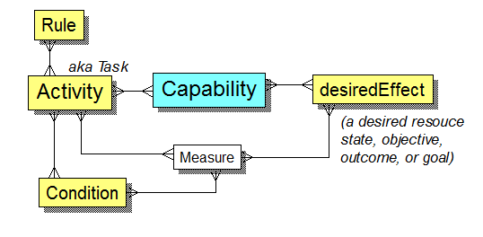
Reification of Capabilities
DoDAF definition of Capability
“The ability to achieve a Desired Effect under specified [performance] standards and conditions through combinations of ways and means [rules, activities, and resources] to perform a set of activities.”
⇒ Capabilities are structures
⇒ to reify them means to reify the structure
For example, in a CV-2, “Capability-1.1 reifies Capability-1” means it reifies the Capability-1 structure:
Capability-1
desiredEffects-C1.i
Tasks-C1.j
Rules-C1.k
Conditions-C1.l
Measures-C1.m
Where “reify” means:
superSubtype,
wholePart, or
overlap

Slide 21
Capability
For each relationship, use the validation rules for that relationship type
Parts of Capabilities | Description of Relationships | Relationship Type
DesiredEffect | Desired Resource States of Capabilities | WholePartType
Activities | Activities that are parts of Capabilities | WholePartType
Conditions | Conditions under which Activities are performed | OverlapType
Rules | Rules contraining Activities | OverlapType
Measures | Measures pertaining to Activities | SuperSubtype
 | Measures pertaining to Conditions | SuperSubtype
 | Measures pertaining to Resources | SuperSubtype
 | Measures of desire | SuperSubtype
 | Measures of effect | SuperSubtype
Performers | Performers performing Activities | OverlapType
 | Perfomers desiring the Resource States of Capabilities | OverlapType
 | Capabilities of Performers | SuperSubtype
CapabilityTypes | Activities that map to types of Capabilities | TypeInstance

Slide 22
Predicate Calculus of Capability Traceability – Desired Effects
Consistency
Completeness

Slide 23
Predicate Calculus of Capability Traceability – Tasks & Conditions
Consistency
Completeness
Notes:
Analogous to prior slide so flip over

Slide 24
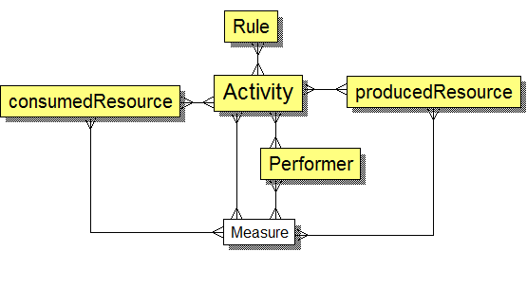
Reification of Activities
DoDAF definition of Activity –
“Work, not specific to a single organization, weapon system or individual that transforms inputs (Resources) into outputs (Resources) or changes their state.”
⇒ Activities are structures
⇒ to reify them means to reify the structure
For example, in an OV-5a, “Activity-1.1 reifies Activity-1”, means it reifies Activity-1’s structure:
Activity-1
consumedResources-A1.i
producedResources-A1.j
Rules-A1.k
Performers-A1.l
Measures-A1.m
Where “reify” means:
superSubtype,
wholePart, or
overlap

Slide 25
Activity
For each relationship, use the validation rules for that relationship type
Parts of Activities | Description of Relationships | Relationship Type
Rules | Rules constraining Activities | OverlapType
Conditions | Conditions under which Activities are performed | OverlapType
Performers | Performers performing Activities | OverlapType
Resources | Resources consumed by Activities | OverlapType
 | Resources produced by Activities | OverlapType
Measures | Measures pertaining to Activities | SuperSubtype
 | Measures pertaining to Conditions | SuperSubtype
 | Measures pertaining to Resources | SuperSubtype

Slide 26
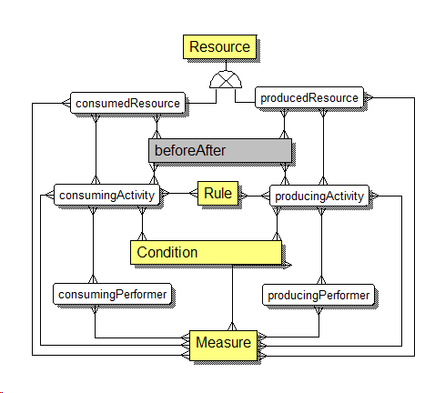
Reification of Resource Flow
DoDAF definition of Resource Flow
“The behavioral and structural representation of the interactions between activities (which are performed by performers) that is both temporal and results in the flow or exchange of things such as information, data, materiel, and performers...”
⇒ in an SV-1, each element of a reified resource flow must be a reification of elements from ordinate resource flows
Note: more complex reifying across allocation levels (e.g., OV→SV) because of typical many-many allocations
Some flows get rolled-up
New ones get created

Slide 27
Resource Flow
For each relationship, use the validation rules for that relationship type
Parts of Resource Flows | Description of Relationships | Relationship Type
Activities | Sequence of Activities | BeforeAfterType
Rules | Rules contraining Activities | OverlapType
Conditions | Conditions under which Activities are performed | OverlapType
Performers | Performers performing Activities | OverlapType
Resources | Resources consumed by Activities | OverlapType
 | Resources produced by Activities | OverlapType
Measures | Measure pertaining to Activities | SuperSubtype
 | Measures pertaining to Conditions | SuperSubtype
 | Measures pertaining to Resources | SuperSubtype
LocationTypes | Location types of where Resources are | OverlapType

Slide 28
Summary
IDEAS provides a structure for mathematical traceability versus document-based or term-based traceability
The predicate calculus can be defined
Future work:
How this could be implemented in tools and databases
Is traceability between reification levels analogous to homeomorphisms in topology?
Determine benefits of mereology versus point set topology and higher-order logic

Slide 29
Questions?
Thank you for your attention!

Slide 30
Backups

Slide 31
How US DoD Thinks of Architectural Descriptions
Most can have Measures
Condition
Guidance
is-performable-under
Rule
Capability
Activity
Standard
Agreement
constrains
requires-ability-to-perform
has
is-performed-by
consumes-and-produces
is-realized-by
Project
achieves-desired-effect (a state of a resource)
is-the-goal-of
Resource
describes-something
Not shown but implied by the IDEAS Foundation:
Everything is 4-D and so has temporal parts, i.e., states
Everything has parts
Everything has subtypes
Information
Materiel
Performer
Data
System
Organization
is-at
Location
Service
PersonRole
GeoPolitical
is-part-of
Notes:
Activity: Work, not specific to a single organization, weapon system or individual that transforms inputs (Resources) into outputs (Resources) or changes their state.
Resource: Data, Information, Performers, Materiel, or Personnel Types that are produced or consumed.
Materiel: Equipment, apparatus or supplies that are of interest, without distinction as to its application for administrative or combat purposes.
Information: The state of a something of interest that is materialized -- in any medium or form -- and communicated or received.
Data: Representation of information in a formalized manner suitable for communication, interpretation, or processing by humans or by automatic means. Examples could be whole models, packages, entities, attributes, classes, domain values, enumeration values, records, tables, rows, columns, and fields.
Performer: Any entity - human, automated, or any aggregation of human and/or automated - that performs an activity and provides a capability.
Organization: A specific real-world assemblage of people and other resources organized for an on-going purpose.
System: A functionally, physically, and/or behaviorally related group of regularly interacting or interdependent elements.
Person Role: A category of persons defined by the role or roles they share that are relevant to an architecture.
Service: A mechanism to enable access to a set of one or more capabilities, where the access is provided using a prescribed interface and is exercised consistent with constraints and policies as specified by the service description. The mechanism is a Performer. The capabilities accessed are Resources -- Information, Data, Materiel, Performers, and Geo-political Extents.
Capability: The ability to achieve a Desired Effect under specified (performance) standards and conditions through combinations of ways and means (activities and resources) to perform a set of activities.
Condition: The state of an environment or situation in which a Performer performs.
Desired Effect: A desired state of a Resource.
Measure: The magnitude of some attribute of an individual.
Location: A point or extent in space that may be referred to physically or logically.
Guidance: An authoritative statement intended to lead or steer the execution of actions.
Rule: A principle or condition that governs behavior; a prescribed guide for conduct or action.
Agreement: A consent among parties regarding the terms and conditions of activities that said parties participate in.
Standard: A formal agreement documenting generally accepted specifications or criteria for products, processes, procedures, policies, systems, and/or personnel.
Project: A temporary endeavor undertaken to create Resources or Desired Effects.
Geopolitical Extent A geospatial extent whose boundaries are by declaration or agreement by political parties.

Slide 32
Before-after Notation
Notes:
Flip over – not time to brief

Slide 33
Validation for Relationship Type: beforeAfter
Before
A1
beforeAfter
B1
After
temporalWP
temporalWP
A
1.1
A
1.2
B
1.1
B
1.2
Validation Check:
Every temporalWP of A1 has a beforeAfter with every temporalWP of B1
If all the temporalWPs of A1 have a beforeAfter with every temporalWP of B1, then A1 must be before B1

Slide 34
Validation for Relationship Type: BeforeAfterType
BeforeType
A1
BeforeAfterType
B1
AfterType
A
1.1
SST /
TemporalWholePartType
A
1.2
B
1.1
SST /
TemporalWholePartType
B
1.2
Validation Check:
Every temporalWPT of A1 must have a BeforeAfterType with B1 and conversely, every temporalWPT of B1 has an inverse BeforeAfterType with A1
Every SST of A1 must have a BeforeAfterType with B1 and conversely, every SST of B1 has an inverse BeforeAfterType with A1
If all the SST of A1 have a BeforeAfterType with any SST of B1, and all the SST of B1 have an inverse BeforeAfterType with any SST of A1, then A1 must be a BeforeAfterType of B1 (Note 1)
If all the temporalWPT of A1 have a BeforeAfterType with every temporalWPT of B1 and all the temporalWPT of B1 have an inverse BeforeAfterType with every temporalWPT of A1, then A1 must be a BeforeAfterType of B1 (Note 2)
Note 1: SST assumes complete subsets
Note 2: temporal WPT assumes complete parts

Slide 35
Predicate Calculus of Activity Traceability – Rules
Consistency
Completeness

